Slide 1
Chapter 17

Slide 2
Objectives

Slide 3
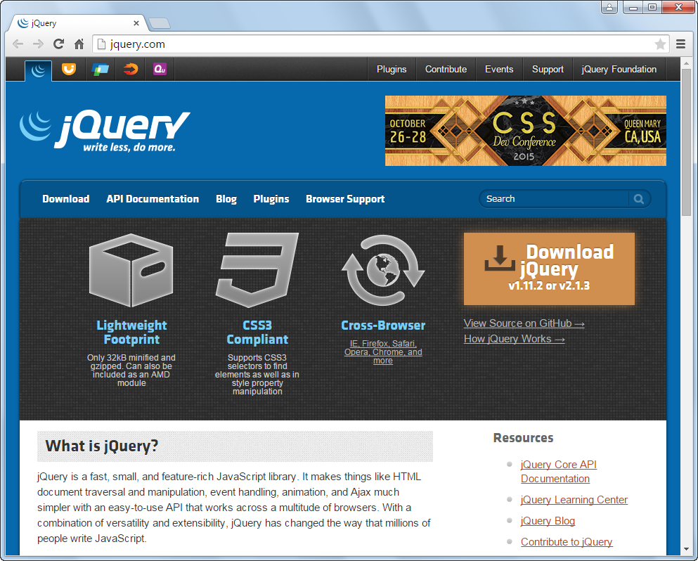
The jQuery website at www.jquery.com

Slide 4
What jQuery offers

Slide 5
When to use jQuery

Slide 6
When to use JavaScript

Slide 7
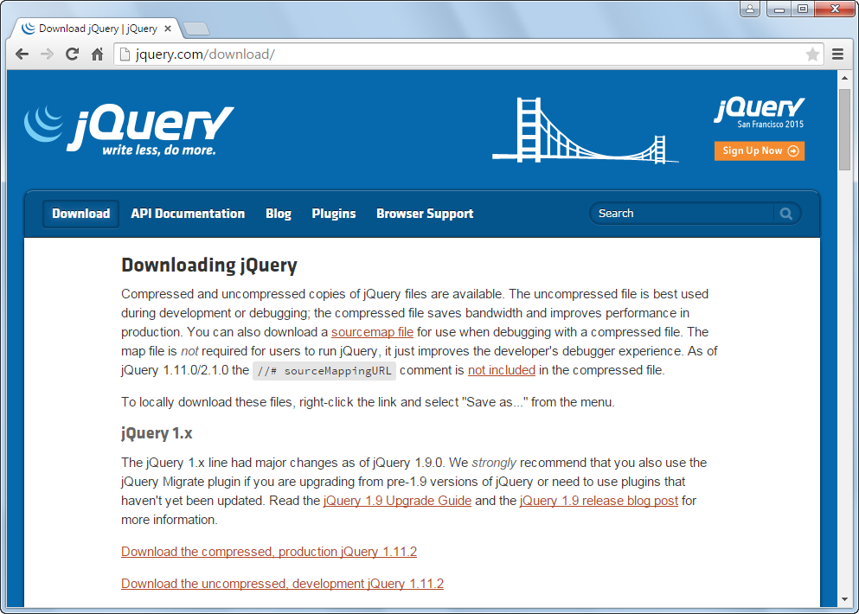
The jQuery page for downloading the latest versions of jQuery

Slide 8
The current versions of jQuery

Slide 9
How to include jQuery 2.1.4 after you’ve downloaded it to your computer

Slide 10
How to code jQuery selectors

Slide 11
How to call jQuery methods

Slide 12
How to code jQuery event methods

Slide 13
Some common jQuery selectors

Slide 14
Some common jQuery methods

Slide 15
Some common jQuery event methods

Slide 16
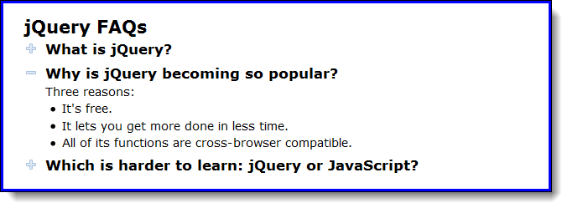
The FAQs application in a browser

Slide 17
The HTML

Slide 18
The critical CSS

Slide 19
The jQuery for the application

Slide 20
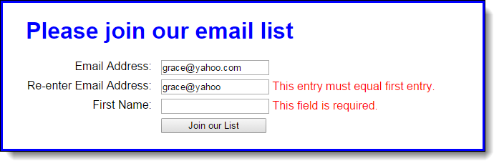
The user interface for the Email List application

Slide 21
The HTML for the Email List application

Slide 22
The HTML (continued)

Slide 23
The jQuery for the Email List app (email_list.js)

Slide 24
The jQuery for the Email List app (continued)

Slide 25
The jQuery for the Email List app (continued)

Slide 26
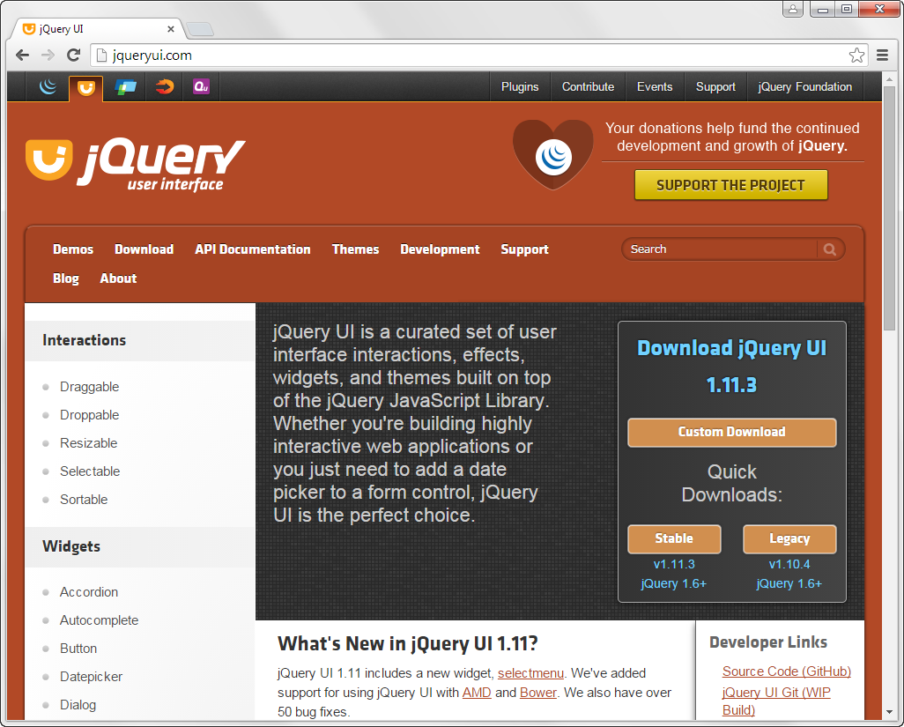
The jQuery UI website (jqueryui.com)

Slide 27
How to include jQuery UI in your application

Slide 28
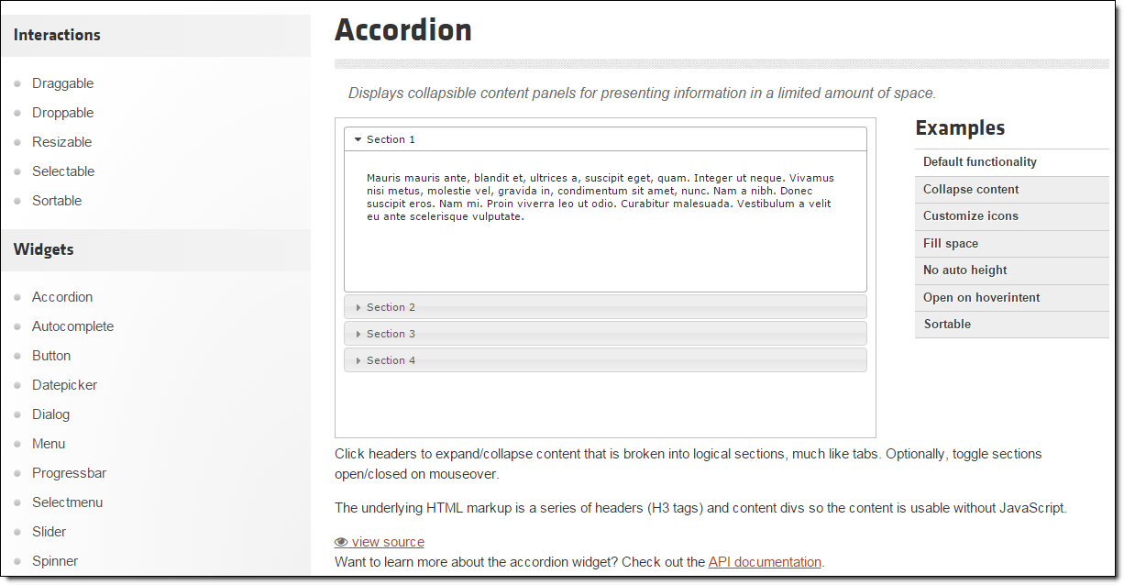
The accordion documentation on the jQuery UI website

Slide 29
How to use the jQuery UI documentation

Slide 30
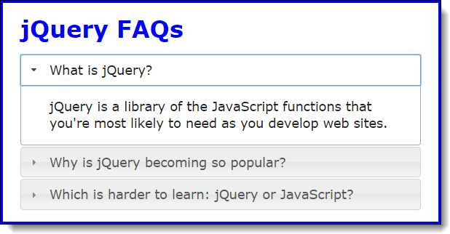
The FAQs application as a jQuery UI accordion

Slide 31
The jQuery for using a widget

Slide 32
The HTML for a jQuery UI accordion

Slide 33
The jQuery code for the jQuery UI accordion

Slide 34
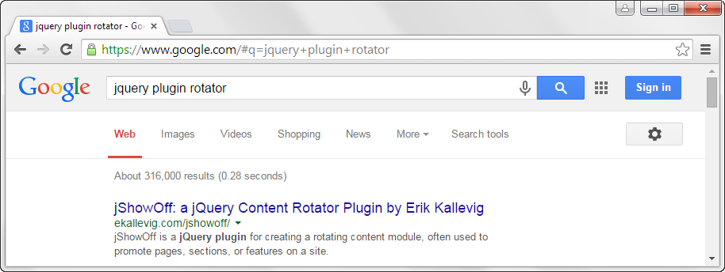
A Google search for a jQuery plugin

Slide 35
Websites for finding jQuery plugins

Slide 36
Popular plugins for displaying images

Slide 37
Popular plugins for slide shows, carousels, and galleries

Slide 38
General steps for using a plugin within your web pages

Slide 39
General steps for using a plugin within your web pages (continued)

Slide 40
The script elements for the jQuery library and the bxSlider plugin

Slide 41
The HTML for the bxSlider plugin

Slide 42
The jQuery for using the bxSlider plugin

Slide 43
Two cautions

Slide 44

A web page that uses the bxSlider plugin for a carousel

Slide 45
The URL for the bxSlider website

Slide 46
The HTML for the bxSlider plugin

Slide 47
The jQuery for using some of the bxSlider options

Slide 48
The module pattern of a jQuery plugin

Slide 49
The module pattern of a jQuery plugin (continued)

Slide 50
Naming conventions for plugin files

Slide 51
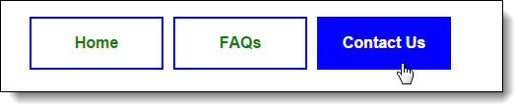
A menu that is highlighted by the highlightMenu plugin

Slide 52
The HTML for the menu

Slide 53
The CSS for the menu

Slide 54
The highlightMenu plugin

Slide 55
The highlightMenu plugin with options

Slide 56
The highlightMenu plugin with options (cont.)

Slide 57
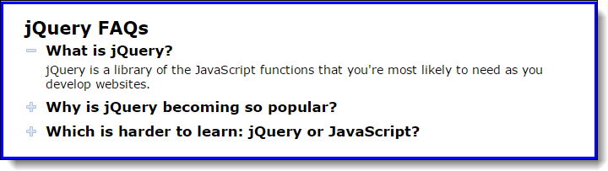
Exercise 17-1 Enhance the jQuery FAQs app

Slide 58
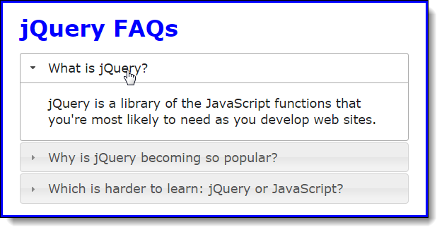
Exercise 17-2 Modify the jQuery UI accordion

Slide 59
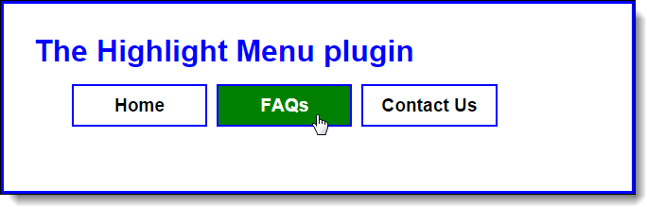
Exercise 17-3 Use the Highlight Menu plugin

Slide 60
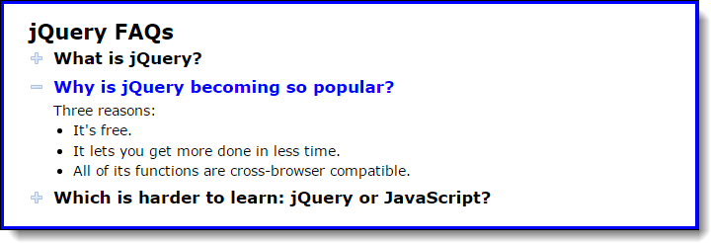
Exercise 17-4 Create a reveal jQuery plugin

Slide 61
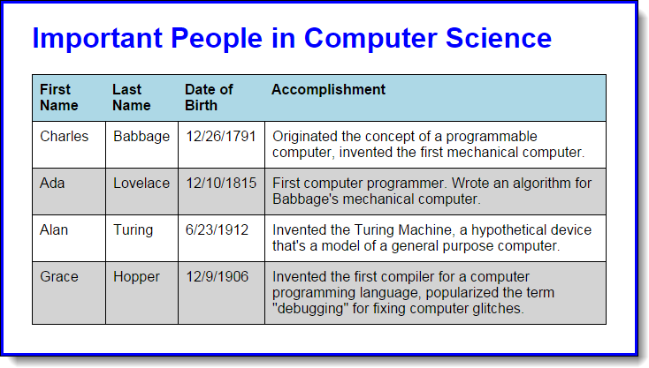
Extra 17-1 Create a jQuery plugin for styles

Slide 62
Extra 17-2 Add options to the jQuery plugin

Slide 63
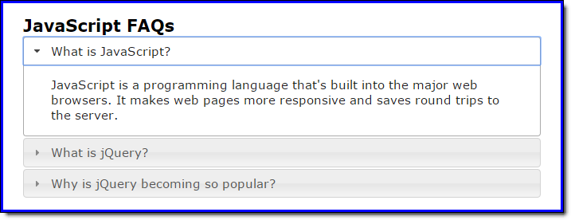
Short 17-1 Convert the FAQs app to a widget

